Slide 1
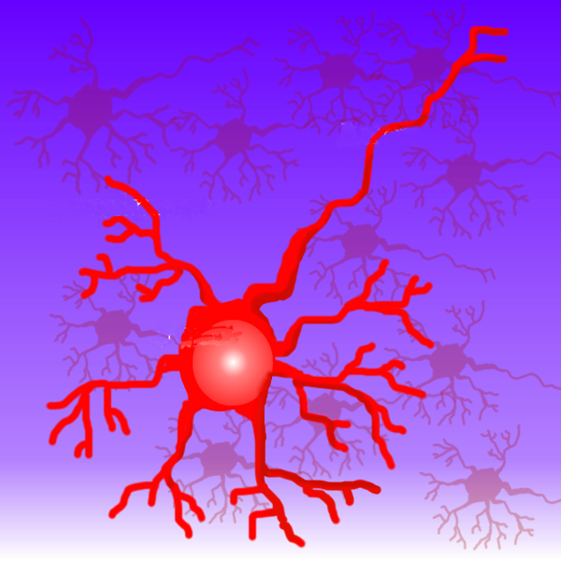
Machine Learning and Neural Networks
Riccardo Rizzo
Italian National Research Council
Institute for Educational and Training Technologies
Palermo - Italy

Slide 2
Definitions
Machine learning investigates the mechanisms by which knowledge is acquired through experience
Machine Learning is the field that concentrates on induction algorithms and on other algorithms that can be said to ``learn.''

Slide 3
Model
A model of learning is fundamental in any machine learning application:
  who is learning (a computer program)
  what is learned (a domain)
  from what the learner is learning (the information source)

Slide 4
A domain
  Concept learning is one of the most studied domain: the learner will try to come up with a rule useful to separate positive examples from negative examples.

Slide 5
The information source
examples: the learner is given positive and negative examples
queries: the learner gets information about the domain by asking questions
experimentation: the learner may get information by actively experiment with the domain

Slide 6
Other component of the model are
the prior knowledge
  of the learner about the domain. For example the learner may know that the unknown concept can be represented in a certain way
the performance criteria
  that defines how we know that the learner has learned something and how it can demonstrate it. Performance criteria can include:
  off line or on line measures
  descriptive or predictive output
  accuracy
  efficiency

Slide 7
What techniques we will see
kNN algorithm
Winnow algorithm
Naïve Bayes classifier
Decision trees
Reinforcement learning (Rocchio algorithm)
Genetic algorithm

Slide 8
k-NN algorithm
The definition of k-nearest neighbors is trivial:
  Suppose that each esperience can be represented as a point in an space For a particular point in question, find the k points in the population that are nearest to the point in question. The class of the majority of the of these neighbors is the class to the selected point.

Slide 9
k-NN algorithm
c
c1
c3
₁
c4
c4
c1
c₂
c2
New input
c4
c3
c2
Inputs already classified
Class 1

Slide 10
k-NN algorithm
Finding the k-nearest neighbors reliably and efficiently can be difficult. Other metrics that the Euclidean can be used.
The implicit assumption in using any k-nearest neighbors technique is that items with similar attributes tend to cluster together.

Slide 11
k-NN algorithm
The k-nearest neighbors method is most frequently used to tentatively classify points when firm class bounds are not established.
The learning is done using only positive examples not negative.

Slide 12
k-NN algorithm
Used in
  Schwab, I., Pohl, W., and Koychev, I. (2000) Learning to recommend from positive evidence. In: H. Lieberman (ed.) Proceedings of 2000 International Conference on Intelligent User Interfaces, New Orleans, LA, January 9-12, 2000, ACM Press, pp. 241-247

Slide 13

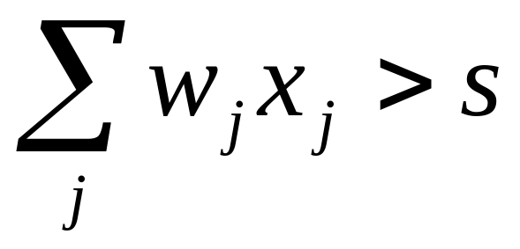
Winnow Algorithm
Is useful to distinguish binary patterns into two classes using a threshold S and a set of weights
the pattern x holds to the class y=1 if
(1)

Slide 14
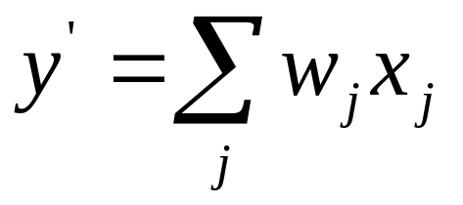
Winnow Algorithm
The algorithm:
  take an example (x, y)
  generate the answer of the classifier
  if the answer is correct do nothing
  else apply some correction

Slide 15
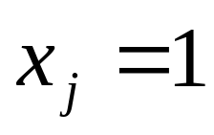
Winnow Algorithm
If y’>y the the weights are too high and are diminished
If y’<y the the weights are too low and are corrected
in both cases are corrected only the ones corresponding to

Slide 16
Winnow Algorithm application
Used in
  M.J. Pazzani “ A framework for Collaborative, Content Based and Demographic Filtering” Artificial Intelligence Review, Dec 1999
  R.Armstrong, D. Freitag, T. Joachims, and T. Mitchell " WebWatcher: A Learning Apprentice for the World Wide Web " 1995.

Slide 17
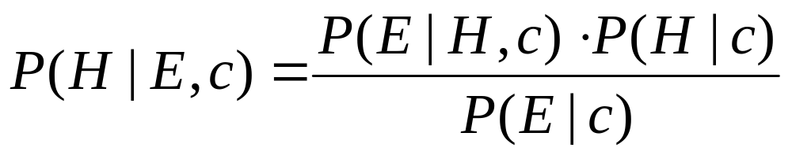
Naïve Bayes Classifier
Bayes theorem : given an Hypotesis H, an Evidence E and a context c

Slide 18
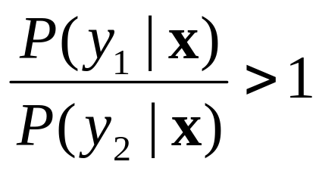
Naïve Bayes Classifier
Suppose to have a set of objects that can hold to two categories, y₁ and y₂, described using n features x₁, x₂, …, x_{n}.
If
then the object holds to the category y₁
We drop
the context

Slide 19
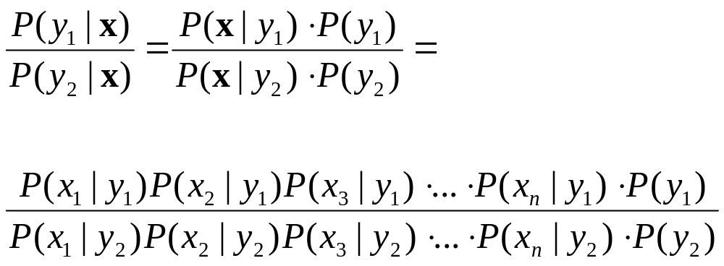
Naïve Bayes Classifier
Using the Bayes theorem:
Supposing that all
the features are
not correlated

Slide 20
Naïve Bayes Classifier
Used in:
  Mladenic, D. (2001) Using text learning to help Web browsing. In: M. Smith, G. Salvendy, D. Harris and R. J. Koubek (eds.) Usability evaluation and interface design. Vol. 1, (Proceedings of 9th International Conference on Human-Computer Interaction, HCI International'2001, New Orleans, LA, August 8-10, 2001) Mahwah, NJ: Lawrence Erlbaum Associates, pp. 893-897.
  Schwab, I., Pohl, W., and Koychev, I. (2000) Learning to recommend from positive evidence. In: H. Lieberman (ed.) Proceedings of 2000 International Conference on Intelligent User Interfaces, New Orleans, LA, January 9-12, 2000, ACM Press, pp. 241-247, also available at .Self, J. (1986) The application of machine learning to student modelling. Instr. Science, Instructional Science 14, 327-338.

Slide 21
Naïve Bayes Classifier
  Bueno D., David A. A. (2001) METIORE: A Personalized Information Retrieval System. In M. Bauer, P. J. Gmytrasiewicz and J. Vassileva (eds.) User Modeling 2001. Lecture Notes on Artificial Intelligence, Vol. 2109, (Proceedings of 8th International Conference on User Modeling, UM 2001, Sonthofen, Germany, July 13-17, 2001) Berlin: Springer-Verlag, pp. 188-198.
  Frasconi P., Soda G., Vullo A., Text Categorization for Multi-page Documents: A HybridNaive Bayes HMM Approach, ACM JCDL’01, June 24-28, 2001

Slide 22
Decision trees
A decision tree is a tree whose internal nodes are tests (on input patterns) and whose leaf nodes are categories (of patterns).
Each test has mutually exclusive and exhaustive outcomes.

Slide 23
Decision trees
T₁
3 classes
4 tests (maybe 4 variables)
T₂
T₃
T₄
2
1
1
1
3
2

Slide 24
Decision trees
The test:
  might be multivariate (tests on several features of the input) or univariate (test only one feature);
  might have two or more outcomes.
The features can be categorical or numerical.

Slide 25
Decision trees
Suppose to have n binary features
The main problem in learning decision trees is to decide the order of tests on variables
In order to decide, the average entropy of each test attribute is calculated and the lower one is chosen.

Slide 26
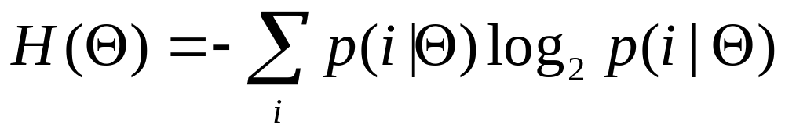
Decision trees
If we have binary patterns and a set of pattern Θ it is possible to write the entropy as
were p(i|Θ) is the probability that a random pattern from Θ belongs to the class i

Slide 27
Decision trees
We will approximate the probability p(i|Θ) using the number of patterns in Θ belonging to the class i divided by the total number of pattern in Θ

Slide 28
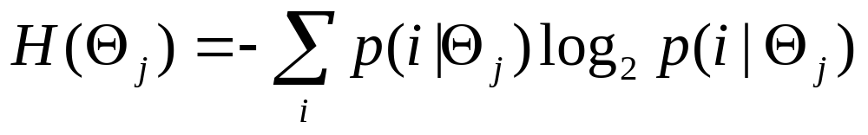
Decision trees
T
If a test T have k outcomes, k subsets Θ₁, Θ₂, ...Θ_{k}, are considered with n₁, n₂, …, n_{k} patterns.
It is possible to calculate:
...
...
1
J
K

Slide 29
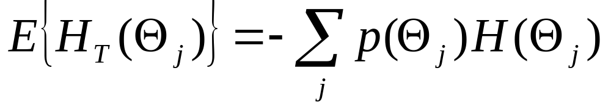
Decision trees
The average entropy over all the Θ_{j}
again we evaluate p(Θ_{j} ) has the number of patterns in Θ that outcomes j divided by the total number of patterns in Θ

Slide 30
Decision trees
We calculate the average entropy for all the test T and chose the lower one.
We write the part of the tree and go head in order to chose again the test that gives the lower entropy

Slide 31
Decision trees
The knowledge in the tree is strongly dependent from the examples

Slide 32
Reinforcement Learning
An agent tries to optimize its interaction with a dynamic environment using trial and error.
The agent can make an action u that applied to the environment changes its state from x to x’. The agent receives a reinforcement r.

Slide 33
Reinforcement Learning
There are three parts of a Reinforcement Learning Problem:
  The environment
  The reinforcement function
  The value function

Slide 34
Reinforcement Learning
The environment
  at least partially observable by means of sensors or symbolic description. The theory is based on an environment that shows its “true” state.

Slide 35
Reinforcement Learning
The reinforcement function
  a mapping from the couple (state, action) to the reinforcement value. There are three classes of reinforcement functions:
    Pure delayed reward: the reinforcements are all zero except for the terminal state (games, inverted pendulum)
    Minimum time to goal: cause an agent to perform actions that generate the shortest path to a goal state

Slide 36
Reinforcement Learning
    Minimization: the reinforcement is a function of of limited resources and the agent have to achieve the goal while minimizing the energy used

Slide 37
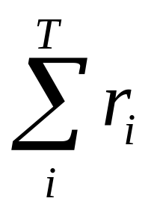
Reinforcement Learning
The Value Function:
  defines how to choose a “good” action. First we have to define
    policy (state) action
    value of a state I (following a defined policy)
    the optimal policy maximize the value of a state
T is the final state

Slide 38
Reinforcement Learning
The Value Function
  is a mapping (state) State Value
  If the optimal value function is founded the optimal policy can be extracted.

Slide 39
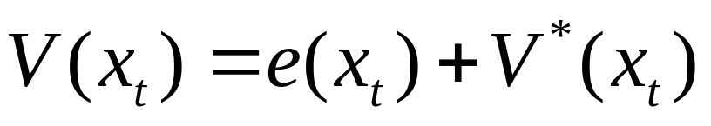
Reinforcement Learning
Given a state x_{t}
V*(x_{t}) is the optimal state value;
V(x_{t}) is the approximation we have;
where e(x_{t}) is the approximation error

Slide 40
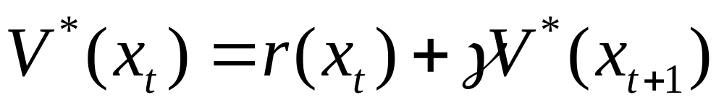
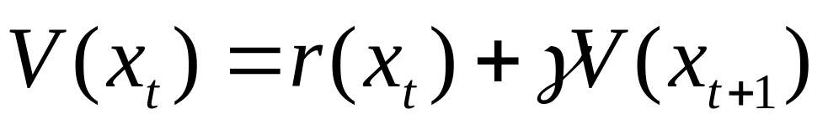
Reinforcement Learning
Moreover
where γ is a discount factor that causes immediate reinforcement to have more importance than future reinforcements

Slide 41
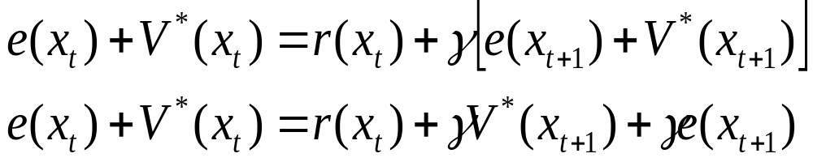
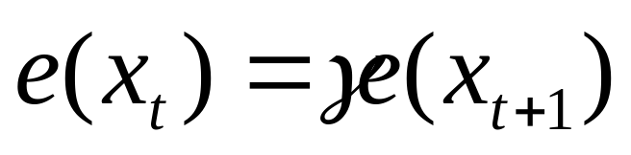
Reinforcement Learning
We can find
that gives
(**)

Slide 42
Reinforcement Learning
The learning process goal is to find an approximation V(x_{t}) that makes the equation (**) true for all the state.
The finale state T of a process has a value that is defined a priori so e(T)=0, so e(T-1)=0 it the (**) is true and then backwards to the initial state.

Slide 43
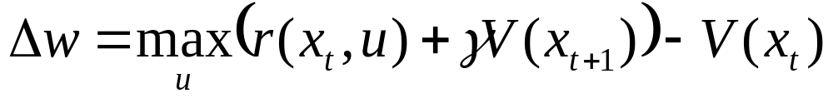
Reinforcement Learning
Assuming that the function approximator for the V* is a look-up table (a table with an approximate state value w for each state) then it is possible to sweep through the state space and update the values in the table according to:

Slide 44
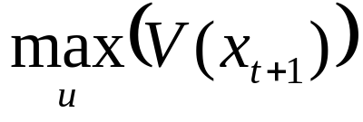
Reinforcement Learning
where u is the action performed that causes the transition to the state x_{t+1}. This must be done by using some kind of simulation in order to evaluate

Slide 45
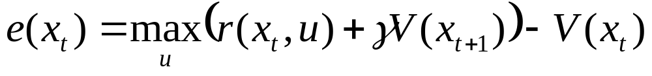
Reinforcement Learning
The last equation can be rewritten as
Each update reduce the value of e(x_{t+1})
the learning stops when e(x_{t+1})=0

Slide 46
Rocchio Algorithm
Used in Relevance Feedback in IR
We represent a user profile and the objects (documents) using the same space
m represents the user
w represent the objects (documents)

Slide 47
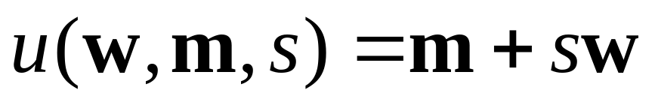
Rocchio Algorithm
The object (document) is matched to the user using an available matching criteria (cosine measure)
The user model is updated using
where s is a function of the feedback

Slide 48
Rocchio Algorithm
It is possible to use a collection of vectors m to represent the user’s interests

Slide 49
Rocchio and Reiforcement Learning
The goal is to have the “best” user’s profile
The state is defined by the weight vector of the user profile

Slide 50
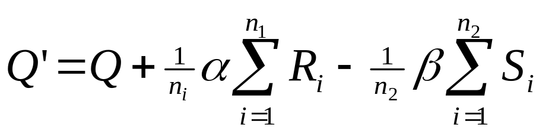
Rocchio Algorithm (IR)
where
Q is the vector of the initial query
R_{i} is the vector for relevant document
S_{i} is the vector for the irrelevant documents
α,β are Rocchio’s weights

Slide 51
Rocchio algorithm
Used in
  Seo, Y.-W. and Zhang, B.-T. (2000) A reinforcement learning agent for personalized information filtering. In: H. Lieberman (ed.) Proceedings of 2000 International Conference on Intelligent User Interfaces, New Orleans, LA, January 9-12, 2000, ACM Press, pp. 248-251
  Balabanovic M. “An Adaptive Web Page Recomandation Service in Proc. Of 1th International Conference on Autonomous Agents 1997

Slide 52
Genetic Algorithms
Genetic algorithms are inspired by natural evolution. In the natural world, organisms that are poorly suited for an environment die off, while those well-suited for it prosper.
Each individual is a bit-string that encodes its characteristics. Each element of the string is called a gene.

Slide 53
Genetic Algorithms
Genetic algorithms search the space of individuals for good candidates.
The "goodness" of an individual is measured by some fitness function. Search takes place in parallel, with many individuals in each generation.

Slide 54
Genetic Algorithms
The algorithm consists of looping through generations. In each generation, a subset of the population is selected to reproduce; usually this is a random selection in which the probability of choice is proportional to fitness.

Slide 55
Genetic Algorithms
Reproduction occurs by randomly pairing all of the individuals in the selection pool, and then generating two new individuals by performing crossover, in which the initial n bits (where n is random) of the parents are exchanged. There is a small chance that one of the genes in the resulting individuals will mutate to a new value.

Slide 56
Neural Networks
An artificial network consists of a pool of simple processing units which communicate by sending signals to each other over a large number of weighted connections.

Slide 57
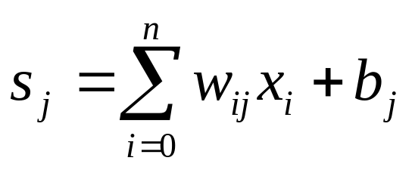
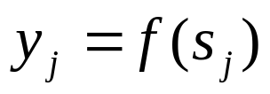
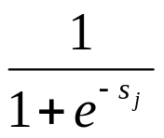
Artificial Neuron
w_{1j}
x₁
w_{2j}
x₂
y_{j}
w_{nj}
x_{n}
b_{j}

Slide 58
Neural Networks
Each unit performs a relatively simple job: receive input from neighbors or external sources and use this to compute an output signal which is propagated to other units (Test stage).
Apart from this processing, there is the task of the adjustment of the weights (Learning stage).
The system is inherently parallel in the sense that many units can carry out their computations at the same time.

Slide 59


Neural Networks
1. Learning stage
2. Test stage
(working stage)
Your knowledge
is useless !!

Slide 60
Classification (connections)
As for this pattern of connections, the main distinction we can make is between:
Feed-forward networks, where the data flow from input to output units is strictly feed-forward. The data processing can extend over multiple layers of units, but no feedback connections or connections between units of the same layer are present.

Slide 61
Classification
Classification (connections)
Recurrent networks that do contain feedback connections. Contrary to feed-forward networks, the dynamical properties of the network are important. In some cases, the activation values of the units undergo a relaxation process such that the network will evolve to a stable state in which these activations do not change anymore.

Slide 62
Recurrent Networks
In other applications, the change of the activation values of the output neurons are significant, such that the dynamical behavior constitutes the output of the network.

Slide 63
Classification (Learning)
We can categorise the learning situations in two distinct sorts. These are:
Supervised learning in which the network is trained by providing it with input and matching output patterns. These input-output pairs are usually provided by an external teacher.

Slide 64
Classification (Learning)
Unsupervised learning in which an (output) unit is trained to respond to clusters of pattern within the input. In this paradigm the system is supposed to discover statistically salient features of the input population. Unlike the supervised learning paradigm, there is no a priori set of categories into which the patterns are to be classified; rather the system must develop its own representation of the input stimuli.

Slide 65
Perceptron
A single layer feed-forward network consists of one or more output neurons, each of which is connected with a weighting factor w_{ij} to all of the inputs x_{i}.
b
x_{i}
b

Slide 66
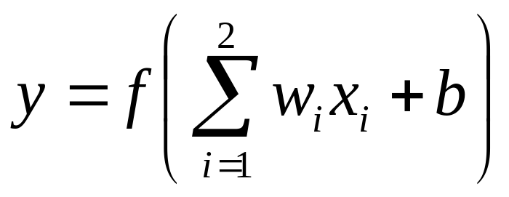
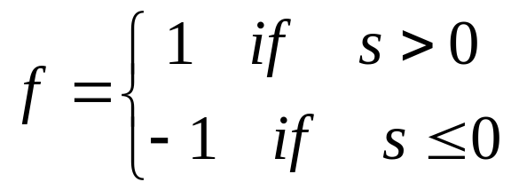
Perceptron
In the simplest case the network has only two inputs and a single output. The output of the neuron is:
suppose that the activation function is a threshold

Slide 67
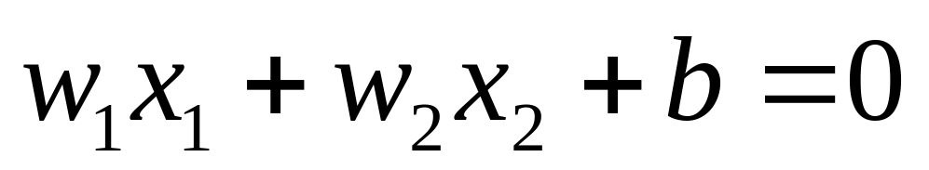
Perceptron
In this example the simple network (the neuron) can be used to separate the inputs in two classes.
The separation between the two classes is given by

Slide 68
Perceptron
x₁
x
x
x
x
x
x
x
x
x
x₂

Slide 69
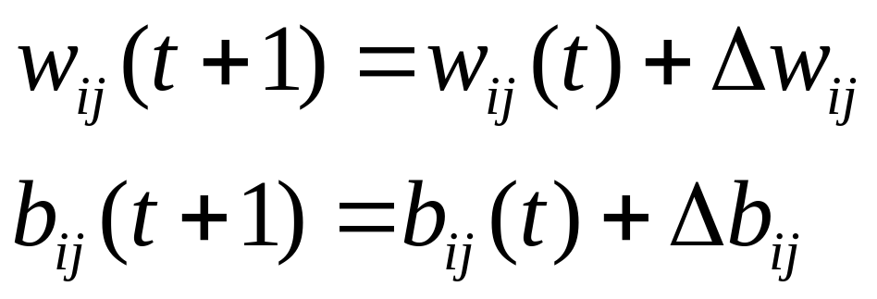
Learning in Perceptrons
The weights of the neural networks are modified during the learning phase

Slide 70
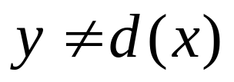
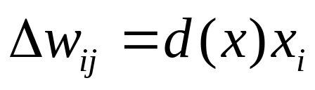
Learning in Perceptrons
Start with random weights
Select an input couple (x, d(x))
if then modify the weight according with
Note that the weights are not modified if the network gives the correct answer

Slide 71
Convergence theorem
If there exists a set of connection weights w* which is able to perform the transformation y = d(x), the perceptron learning rule will converge to some solution (which may or may not be the same as w* ) in a finite number of steps for any initial choice of the weights.

Slide 72
Linear Units
w_{1j}
w_{2j}
Y_{j}=s_{j}
x₂
w_{nj}
x_{n}
b_{j}

Slide 73
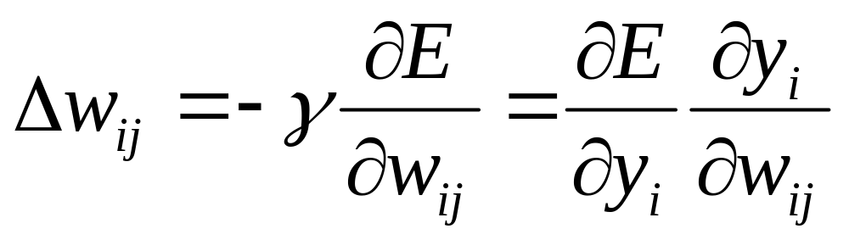
The Delta Rule 1
The idea is to make the change of the weight proportional to the negative derivative of the error

Slide 74
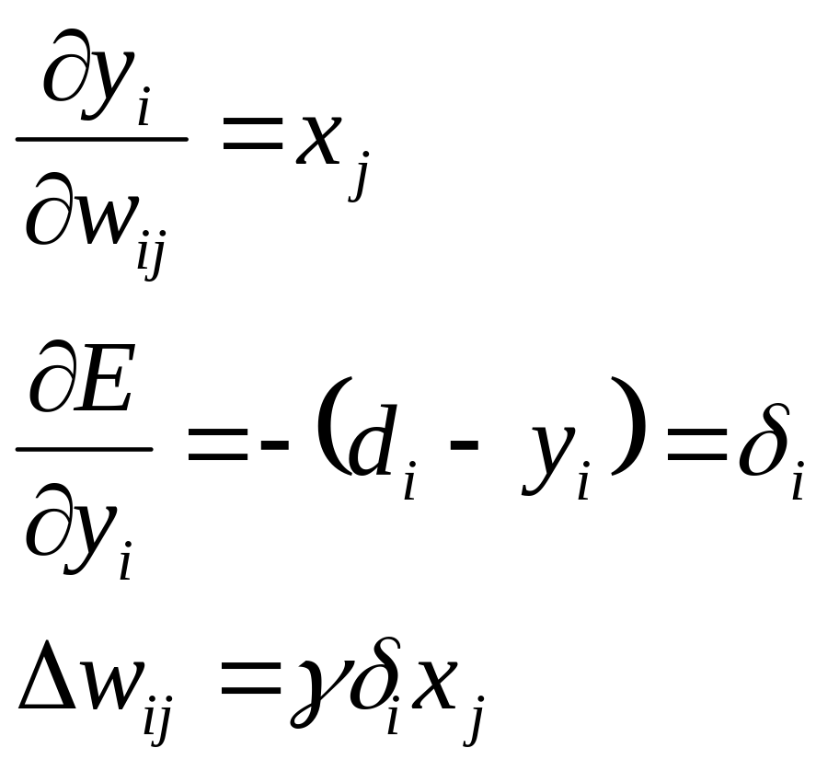
The Delta Rule 2
(1)

Slide 75
Backpropagation
The multi-layer networks with a linear activation can classify only linear separable inputs or, in case of function approximation, only linear functions can be represented.

Slide 76
Backpropagation
y_{i}
w_{ij}
h_{j}
v_{jk}
. . .
x₁
x₂
x_{n}

Slide 77
Backpropagation
When a learning pattern is clamped, the activation values are propagated to the output units, and the actual network output is compared with the desired output values, we usually end up with an error in each of the output units. Let's call this error e_{o} for a particular output unit o. We have to bring e_{o} to zero.

Slide 78
Backpropagation
The simplest method to do this is the greedy method: we strive to change the connections in the neural network in such a way that, next time around, the error e_{o} will be zero for this particular pattern. We know from the delta rule that, in order to reduce an error, we have to adapt its incoming weights according to the last equation (1)

Slide 79
Backpropagation
In order to adapt the weights from input to hidden units, we again want to apply the delta rule. In this case, however, we do not have a value for for the hidden units.

Slide 80
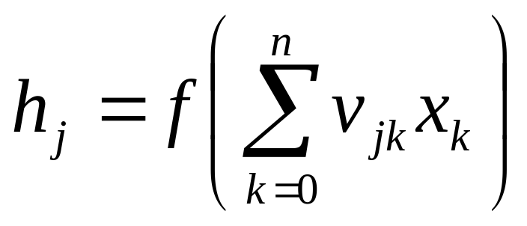
Backpropagation
Calculate the activation of the hidden units

Slide 81
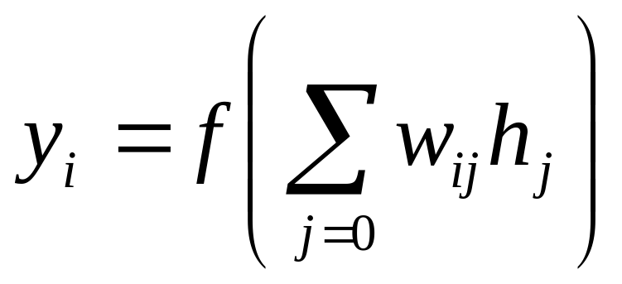
Backpropagation
And the activation of the output units

Slide 82
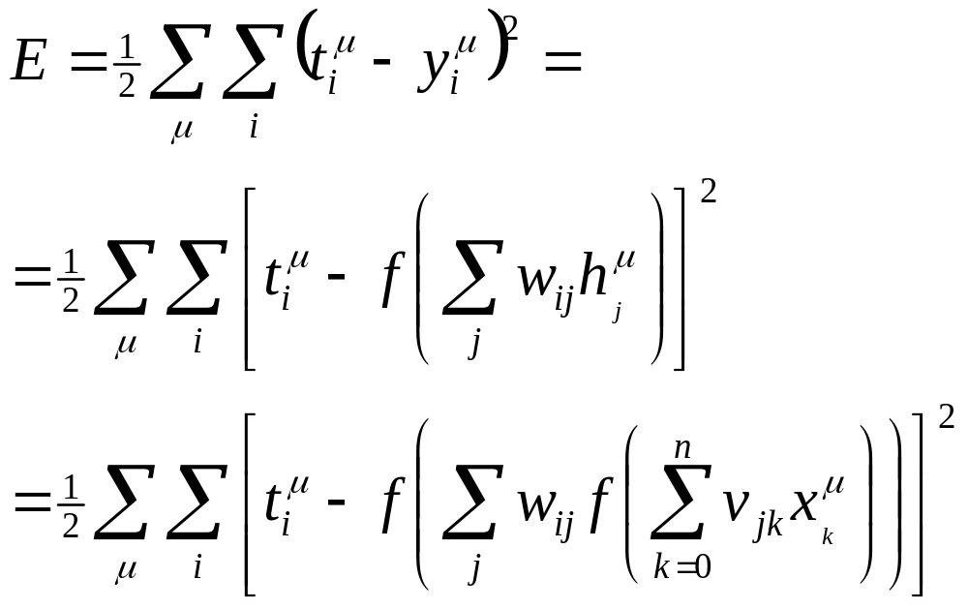
Backpropagation
If we have μ pattern to learn the error is

Slide 83
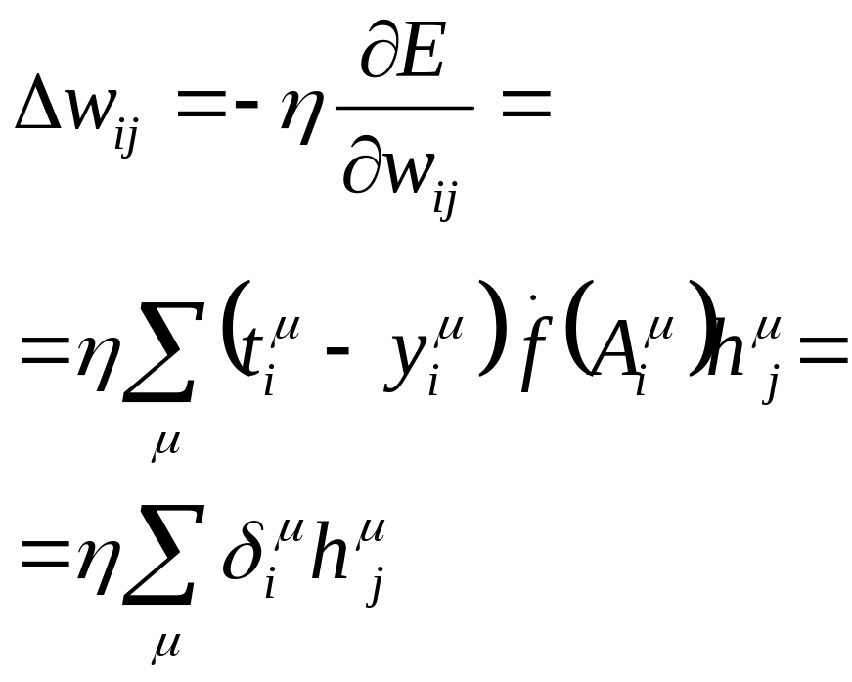
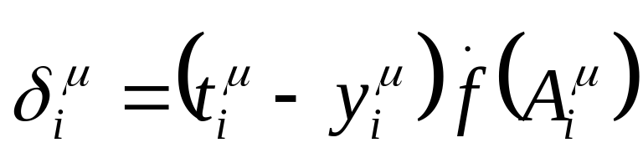
Backpropagation

Slide 84
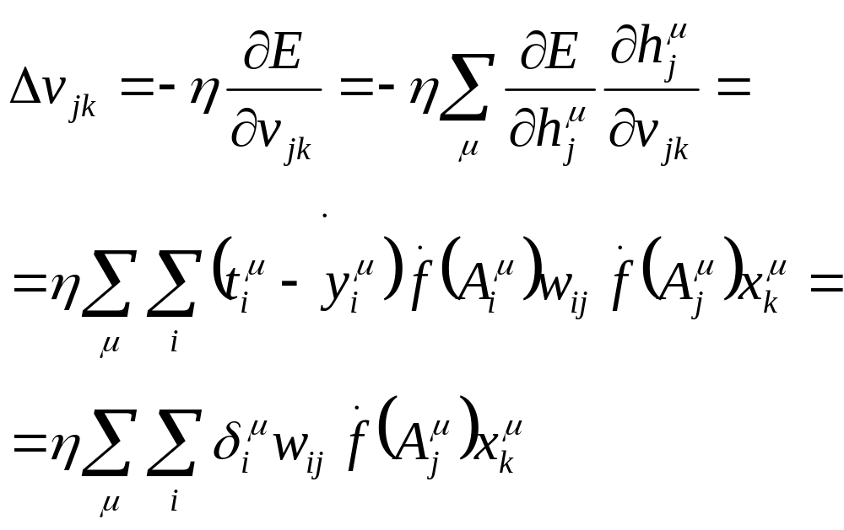
Backpropagation

Slide 85
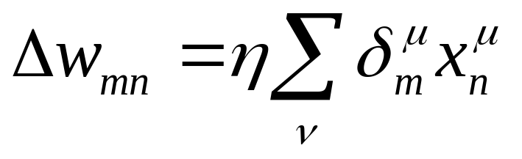
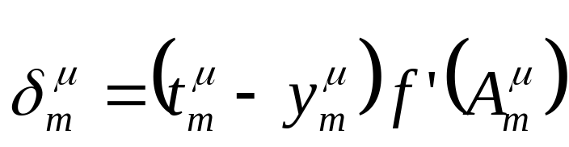
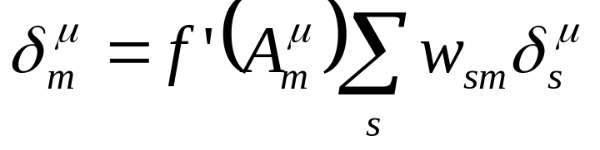
Backpropagation
The weight correction is given by :
Where
If m is the output layer
or
If m is an hidden layer

Slide 86
Backpropagation
y_{i}
w_{ij}
h_{j}
v_{jk}
. . .
x₁
x₂
x_{n}

Slide 87
Backpropagation
y_{i}
w_{ij}
h_{j}
v_{jk}
. . .
x₁
x₂
x_{n}

Slide 88
Recurrent Networks
What happens when we introduce a cycle? For instance, we can connect a hidden unit with itself over a weighted connection, connect hidden units to input units, or even connect all units with each other ?

Slide 89
Hopfield Network
The Hopfield network consists of a set of N interconnected neurons which update their activation values asynchronously and independently of other neurons.
All neurons are both input and output neurons. The activation values are binary (+1, -1)

Slide 90
Hopfield Network

Slide 91
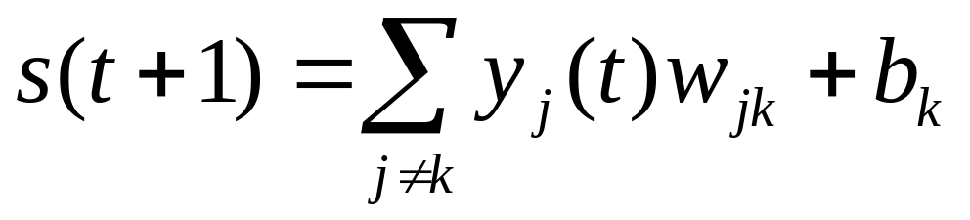
Hopfield Network
The state of the system is given by the activation values y = (y _{k} ).
The net input s _{k} (t +1) of a neuron k at cycle (t +1) is a weighted sum

Slide 92
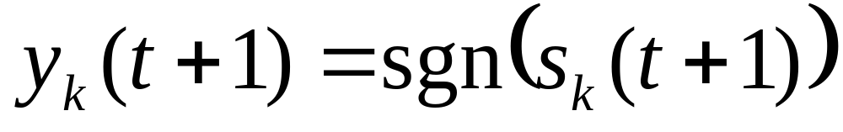
Hopfield Network
A threshold function is applied to obtain the output

Slide 93
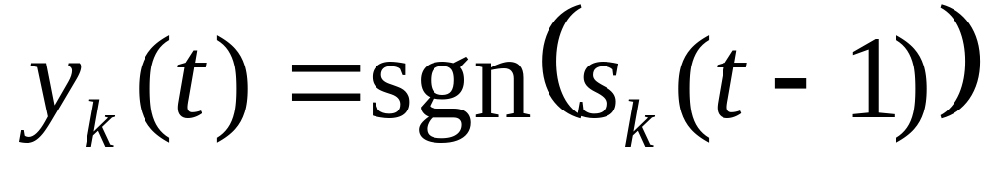
Hopfield Network
A neuron k in the net is stable at time t I.e.
A state is state if all the neurons are stable

Slide 94
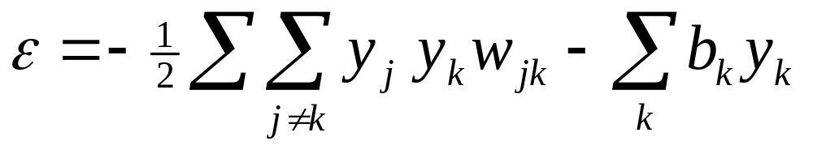
Hopfield Networks
If w_{jk} = w_{kj} the behavior of the system can be described with an energy function
This kind of network has stable limit points

Slide 95
Hopfield net. applications
A primary application of the Hopfield network is an associative memory.
The states of the system corresponding with the patterns which are to be stored in the network are stable.
These states can be seen as `dips' in energy space.

Slide 96
Hopfield Networks
It appears, however, that the network gets saturated very quickly, and that about 0.15N memories can be stored before recall errors become severe.

Slide 97
Hopfield Networks
Input
Stable
state
State
state

Slide 98
Hopfield Networks
Used in
  Chung, Y.-M., Pottenger, W. M., and Schatz, B. R. (1998) Automatic subject indexing using an associative neural network. In: I. Witten, R. Akscyn and F. M. Shipman III (eds.) Proceedings of The Third ACM Conference on Digital Libraries (Digital Libraries '98), Pittsburgh, USA, June 23-26, 1998, ACM Press, pp. 59-6

Slide 99
Self Organization
The unsupervised weight adapting algorithms are usually based on some form of global competition between the neurons.
Applications of self-organizing networks are:

Slide 100
S.O. Applications
clustering: the input data may be grouped in `clusters' and the data processing system has to find these inherent clusters in the input data.

Slide 101
S.O. Applications
vector quantisation: this problem occurs when a continuous space has to be discretised. The input of the system is the n-dimensional vector x, the output is a discrete representation of the input space. The system has to find optimal discretisation of the input space.

Slide 102
S.O. Applications
dimensionality reduction: the input data are grouped in a subspace which has lower dimensionality than the dimensionality of the data. The system has to learn an “optimal” mapping.

Slide 103
S.O. Applications
feature extraction: the system has to extract features from the input signal. This often means a dimensionality reduction as described above.

Slide 104
Self-Organizing Networks
Learning Vector Quantization
Kohonen maps
Principal Components Networks
Adaptive Resonance Theory

Slide 105
Kohonen Maps
In the Kohonen network, the output units are ordered in some fashion, often in a two-dimensional grid or array, although this is application-dependent.

Slide 106
Kohonen Maps

Slide 107
Kohonen Maps
The input x is given to
all the units at the same
time

Slide 108
Kohonen Maps
The weights
of the winner unit
are updated
together with the weights of
its neighborhoods

Slide 109
Kohonen Maps
Used in:
  Fulantelli, G., Rizzo, R., Arrigo, M., and Corrao, R. (2000) An adaptive open hypermedia system on the Web. In: P. Brusilovsky, O. Stock and C. Strapparava (eds.) Adaptive Hypermedia and Adaptive Web-Based Systems. Lecture Notes in Computer Science, (Proceedings of Adaptive Hypermedia and Adaptive Web-based Systems, AH2000, Trento, Italy, August 28-30, 2000) Berlin: Springer-Verlag, pp. 189-201.
  Goren-Bar, D., Kuflik, T., Lev, D., and Shoval, P. (2001) Automating personal categorizations using artificial neural network. In: M. Bauer, P. J. Gmytrasiewicz and J. Vassileva (eds.) User Modeling 2001. Lecture Notes on Artificial Intelligence, Vol. 2109, (Proceedings of 8th International Conference on User Modeling, UM 2001, Sonthofen, Germany, July 13-17, 2001) Berlin: Springer-Verlag, pp. 188-198.

Slide 110
Kohonen Maps
  Kayama, M. and Okamoto, T. (1999) Hy-SOM: The semantic map framework applied on an example case of navigation. In: G. Gumming, T. Okamoto and L. Gomez (eds.) Advanced Research in Computers and Communications in Education. Frontiers ub Artificial Intelligence and Applications, Vol. 2, (Proceedings of ICCE'99, 7th International Conference on Computers in Education, Chiba, Japan, 4-7 November, 1999) Amsterdam: IOS Press, pp. 252-259.
  Taskaya, T., Contreras, P., Feng, T., and Murtagh, F. (2001) Interactive visual user interfaces to databases. In: M. Smith, G. Salvendy, D. Harris and R. J. Koubek (eds.) Usability evaluation and interface design. Vol. 1, (Proceedings of 9th International Conference on Human-Computer Interaction, HCI International'2001, New Orleans, LA, August 8-10, 2001) Mahwah, NJ: Lawrence Erlbaum Associates, pp. 913-917.

Slide 111
Papers on Self--Organizing Networks used in Information organization
  Honkela, T., Kaski S., Lagus K., and Kohonen T., Newsgroup exploration with WEBSOM method and browsing interface, Technical Report A32, Helsinki University of Technology, Laboratory of Computer and Information Science, Espoo. WEBSOM home page (1996) available at http://websom.hut.fi/websom/ .
  Kaski S., Honkela T., Lagus K., Kohonen T., Creating an order in digital libraries with self-organizing maps , in Proc. of WCNN'96, World Congress on Neural Networks, (San Diego, Sept. 15-18, 1996), pp. 814-817.
  Kaski S., Data exploration using self-organizing maps. Acta Polytecnica Scandinavica, Mathematics, Computing and Management in Engineering Series No. 82, Espoo 1997, 57 pp. Published by the Finnish Academy of Technology.
  Kohonen T., Kaski S., Lagus K., Honkela T., Very Large Two-Level SOM for the Browsing of the Newsgroups, in Proc. of ICANN'96, (Bochum, Germany, July 16-19 1996), Lecture Notes in Computer Science, Spriger, vol.112, pp 269-274.

Slide 112
Papers on Self--Organizing Networks used in Information organization 2
  Lagus K., Honkela T., Kaski S., Kohonen T., WEBSOM--Self Organizing maps of Document Collections , Neurocomputing 21 (1998), 101-117
  Lin X., Soergel D., Marchionini G., A Self-Organizing Semantic Map for Information Retrieval, in Proc. of the Fourteenth Annual International ACM/SIGIR Conference on Research and Development in Information Retrieval (Chicago IL, Oct. 13-16, 1991), pp. 262-269.
  Merkel D., Rauber A., Self-Organization of Distributed Document Archives , in Proc. of the 3rd Int'l Database Engineering and Applications Symposium, IDEAS'99, (Montreal, Canada, Aug. 2-4, 1999).
  Rauber A., Merkel D., Creating an Order in Distributed Digital Libraries by Integrating Independent Self-Organizing Maps , in Proc. of ICANN'98, (Skovde, Sweden, Sept. 2-4, 1998).
  Merkel D., Tjoa M., Kappel G., A Self--Organizing Map that Learns the Semantic Similarity of Reusable Software Components , ACNN'94, Jan 31-Feb 2, 1994, pp. 13-16.

Slide 113
Self-Organizing Networks
Demo

